Slide 1



IHE Devices – SDPi Supplement
Introduction & Overview
<date> 2020
SDC is a registered trademark of OR.NET
(Version 1.2 2020.10.30A)

Slide 2
IHE Germany – SDC / SDPi Plug-a-Thon – Briefing
IHE Basics - Why profile?
From ISO/IEEE 11073 SDC to IHE SDPi TF to PATs & CATs
Orientation Tour: IHE Technical Framework & SDPi Profiles
IHE SDPi Profile Option Specifications
IHE SDPi TF-2 Transactions & MDPWS Messaging
IHE SDPi TF-3 SDC/BICEPS Content Modules & Specializations

Slide 3
First … Term Usage & Assumptions
SDC Service-oriented Device Connectivity Family of ISO/IEEE 11073 SDC standards Assumption: PAT participants have a working understanding of SDC
SDPi Service-oriented Device Point-of-care Interoperability Set of (4) IHE technical framework profiles based on ISO/IEEE 11073 SDC standards Assumption: PAT participants may have some working knowledge of IHE & TF profiles
PAT Plug-a-thon IHE testing event intended for early, informal exploration of new tech & new profiles Assumption: PAT participants may have background in “hackathons”, plugfests, etc.
CAT Connectathon IHE formal interoperability testing event for published profiles; includes independent monitors, test management tooling; published results Assumption: PAT participants may have background in formal test invents

Slide 4
Second … Profiles? Why?!
IHE Profile A technical specification that constrains a set of general open standards for application to a specific interoperability or integration need (described by a set of use cases) ¹
Why profiles?
As users and implementers agree how to use standards to address specific integration needs, optionality must be minimized, coordinated usage of multiple standards considered, and national / regional allowances factored
Isn’t a well architected family of standards sufficient?
The needs of an implementation community are often both narrower than the set of possible applications that are covered by foundational / core standards, such as ISO/IEEE 11073 SDC, as well as broader in scope requiring additional standards to be integrated.
¹ Not to be confused with an HL7 FHIR Profile, which is similar in concept but very different in application

Slide 5
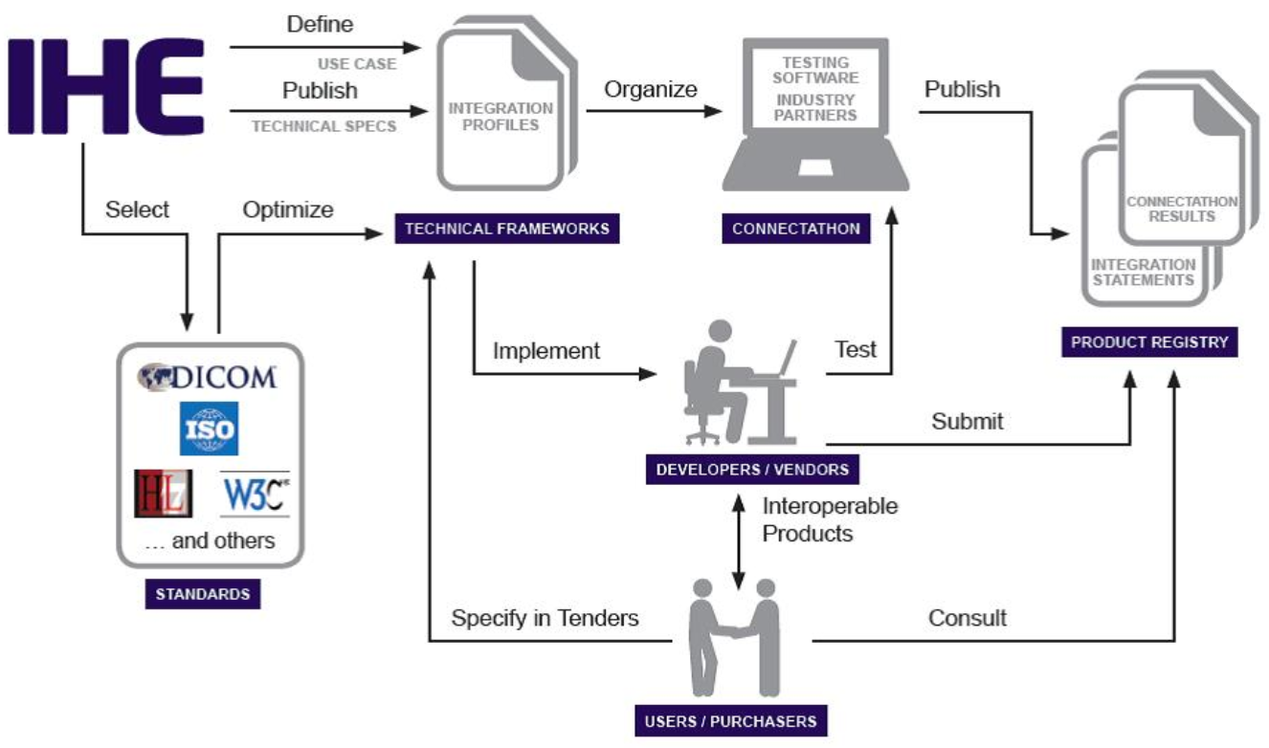
IHE Process Overview
Source: https://www.ihe.net/about_ihe/ihe_process/

Slide 6
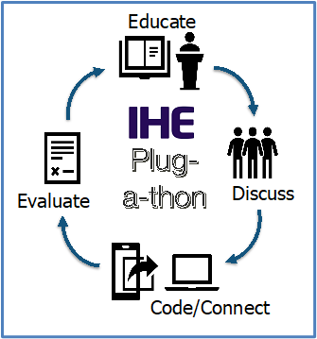
IHE Plug-a-thon (PAT) Basics
IHE Testing Events –
Pathway to CA & Certification!

Slide 7
<Add a simple CAT overview slide / graphic>
SDC / SDPi Distinctives … SOA / DPI / PnT / SOMDA …WS*
Drives CA & Tooling challenges!

Slide 8
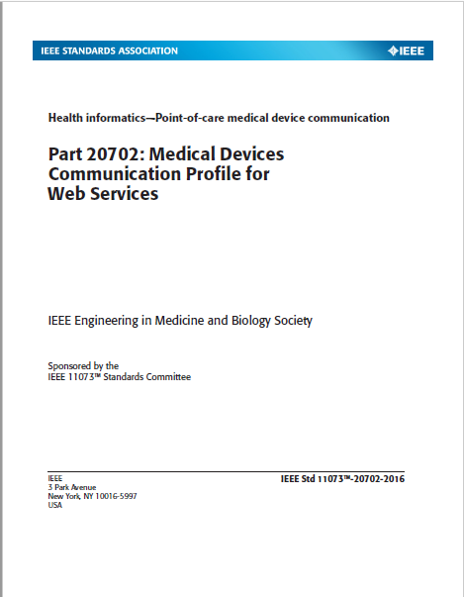
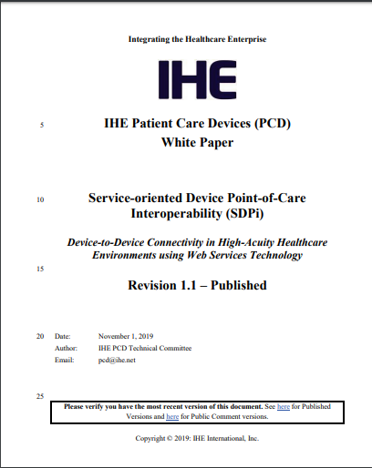
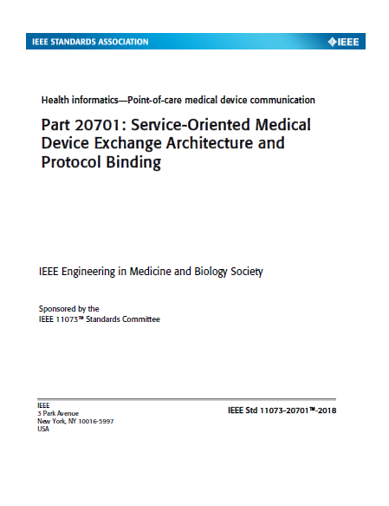
Orientation Tour: IHE TF & SDPi Profiles
2019 SDPi paper established rationale and strategy for profiling ISO/IEEE 11073 SDC in IHE Technical Framework profile specifications.
https://www.ihe.net/uploadedFiles/Documents/PCD/IHE_PCD_WP_SDPi_Rev1-1_Pub_2019-11-01.pdf
https://wiki.ihe.net/index.php/SDC@IHE_White_Paper

Slide 9
<from Use Cases/Scenarios to Profiles to Test Scripts>
Profiles constrained to test scripts (full circle – see IHE Process overview)
Link to detail in SDPi profiles / supplement (from narrative to Gherkin)
Drives profile requirement => test plan / test cases / scripts …

Slide 10
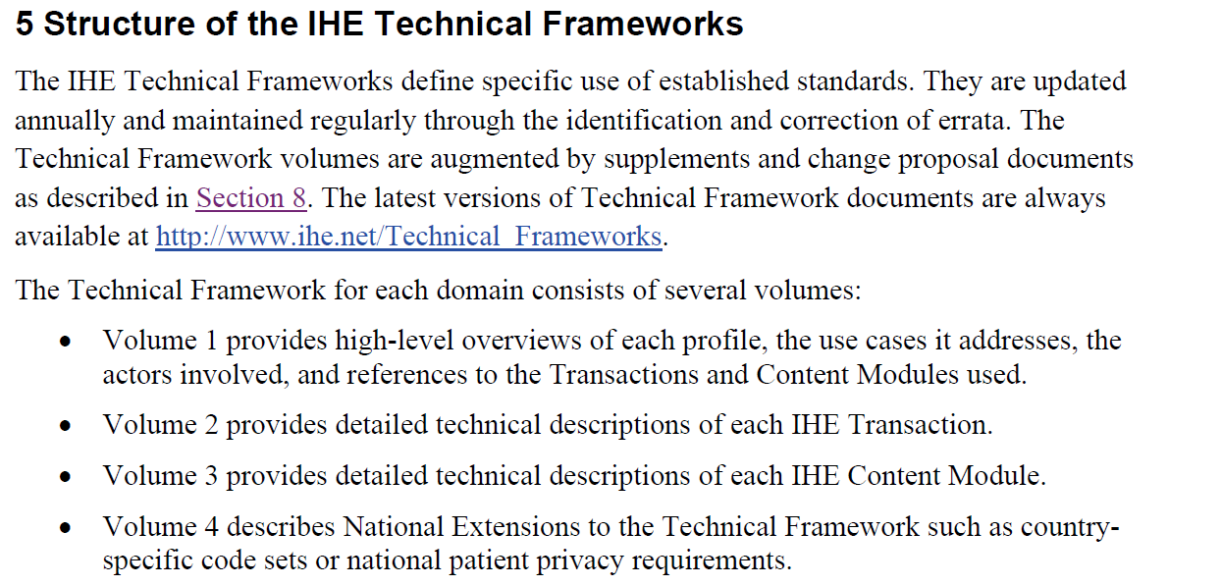
Orientation Tour: IHE TF & SDPi Profiles
Source: https://www.ihe.net/uploadedFiles/Documents/Templates/IHE_TF_General_Introduction.pdf

Slide 11
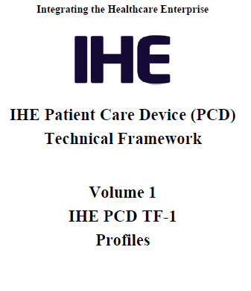
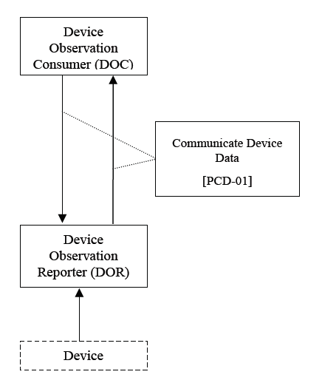
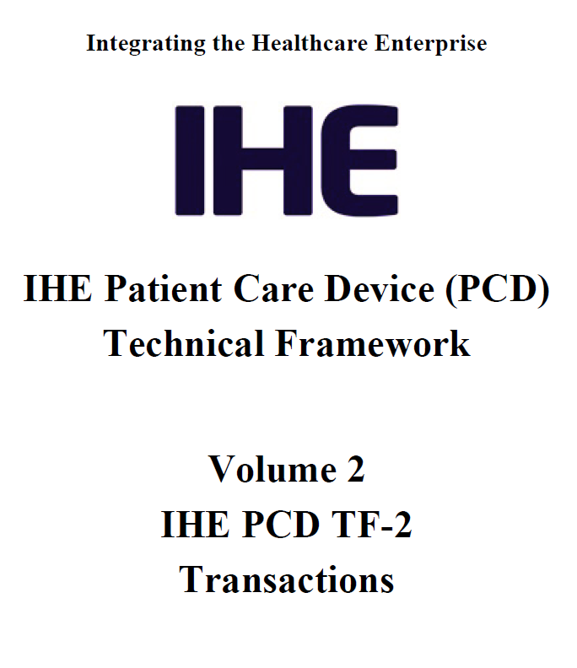
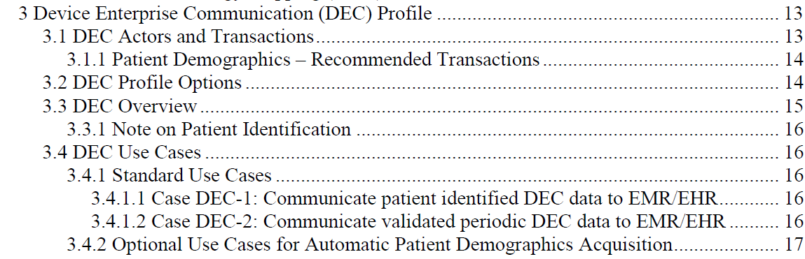
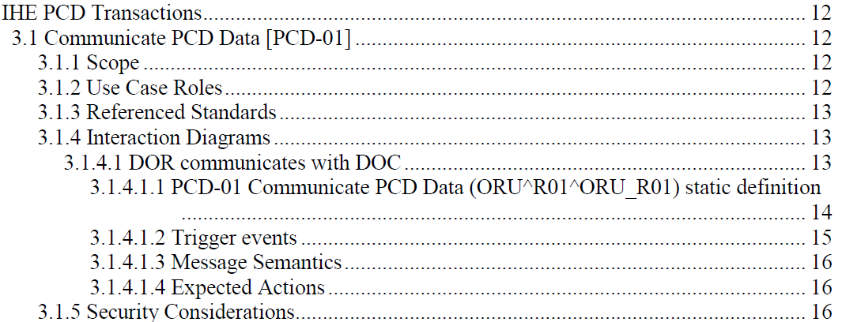
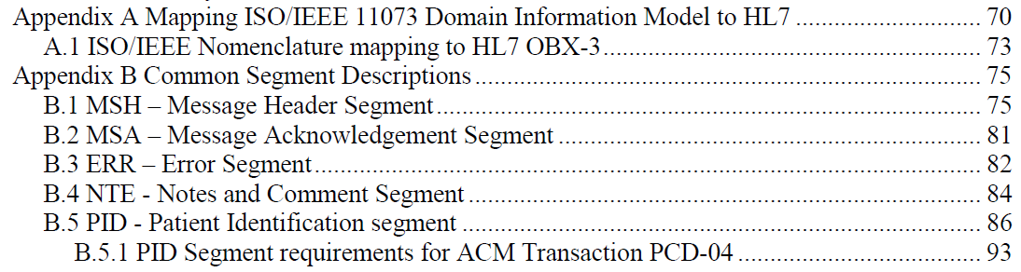
Orientation Tour: Example – IHE DEC Profile
TF-1 Profile calls out TF-2 Transaction(s) – may add usage constraints
TF-2 Common Transaction Message Elements are Specified Once in Appendices
NOTE: Only message profiling specifications included, relying on references to base message standards for all additional details.

Slide 12
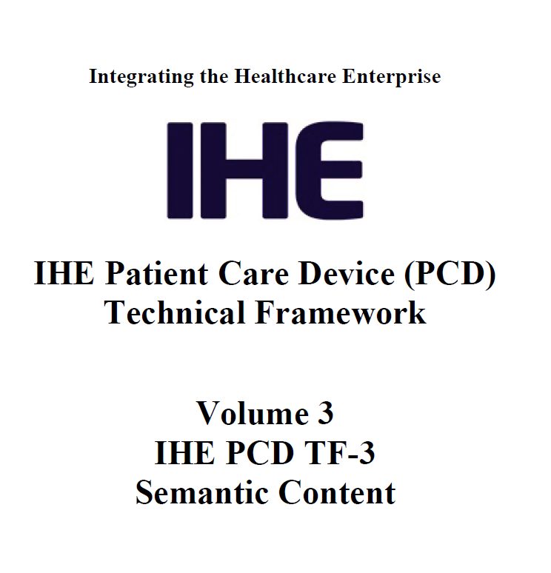
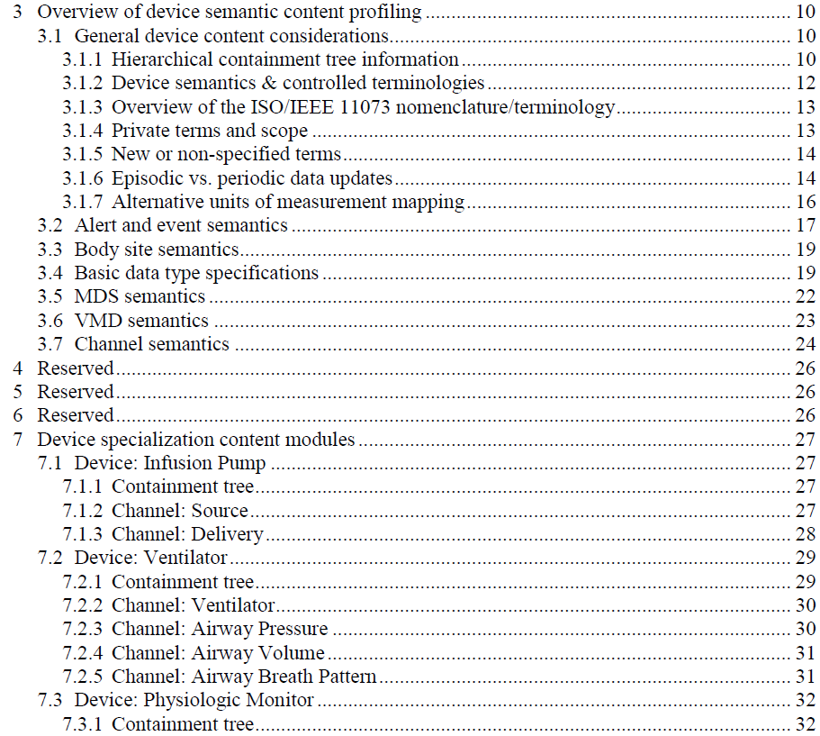
Orientation Tour: Example – IHE DEC Profile
General semantic content profiling specifications
TF-3 Bindings only generally referenced in DEC profile & DEV-01 Transaction
Device Specializations – Apply General to Specific types

Slide 13
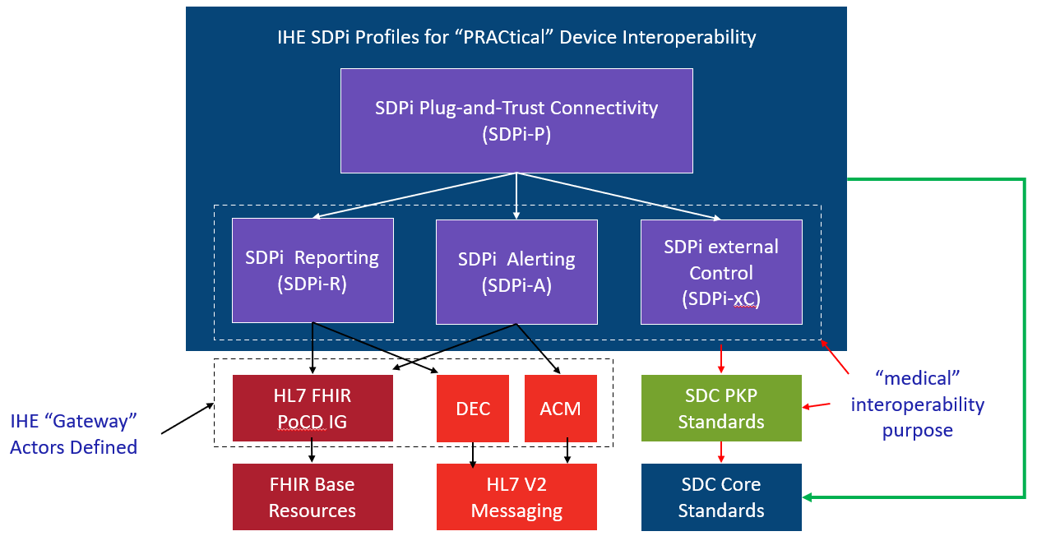
Orientation Tour: IHE TF & SDPi Profiles
Service-oriented Device Point-of-care Interoperability (SDPi)
Four profile specifications:
SDPi-P for Plug-and-Trust Interoperability
SDPi-R for Reporting Medical Information
SDPi-A for Alerting
SDPi-xC for External Controlling
Three IHE DEV TF Volumes:
TF-1 Profiles / use cases / actors / …
TF-2 Transactions / MDPWS messaging
TF-3 BICEPS content modules / device specializations
See draft SDPi Supplement Word Document for additional content detail & outline (https://github.com/IHE/sdpi-fhir/tree/master/SDPi%20%20Supplement/SDPi%20Rev%201.0)

Slide 14
Orientation Tour: From Volume 1 to 2 to 3
SDPi TF Supplement Vol.1 Integration Profiles
SDPi-P Profile
Profile Actors & Transactions & Content Modules
Profile Actor Options
Profile Overview (Concepts & Use Cases)
SES Considerations
SDPi-Reporting Profile …
SDPi-Alerting Profile …
SDPi-xControl Profile …
Appendix A: Requirements Management for Plug-n-Trust Interoperability
Appendix B: ISO/IEEE 11073 SDC Requirements Coverage
<including ISO/IEEE 11073 SDC ICS tables>
Appendix C: Device Point-of-care Interoperability Use Cases
<including Gherkin detail & links to Compendium etc.>
SDPi TF Supplement Vol.2 Transactions
DEV-23 Announce Network Presence
Scope
Actor Roles & Referenced Standards
Messages (at BICEPS level w/ links to Appendix A)
Protocol Requirements
SES Considerations
DEV-24 Discover Network Participants
…
DEV-44 Invoke Medical Control Services
Appendix A: ISO/IEEE 11073 SDC / MDPWS Message Specifications (Normative)
SDC/BICEPS to SDC/MDPWS Message Specifications
Messages for BICEPS Discovery Model
<specific MDPWS message links>
<example exchanges & library calls>
MDPWS Message Detail in Appendix
M:N Profiles & Transactions
See SDPi Supplement (1.0) document in the IHE sdpi-fhir Github repository for full details.

Slide 15
Orientation Tour: From Volume 1 to 2 to 3
SDPi TF Supplement Vol.1 Integration Profiles
SDPi-P Profile
Profile Actors & Transactions & Content Modules
Profile Actor Options
Profile Overview (Concepts & Use Cases)
SES Considerations
SDPi-Reporting Profile …
SDPi TF Supplement Vol.3 Content Modules
DEV Semantic Content Modules
General Device Content Considerations
…
SDC / BICEPS Semantic Content
DEV Specialization Content Modules
Device: Infusion Pump
…
SDC / BICEPS Content Module
Device: Ventilator …
Device: Physiologic Monitor …
Devices: Surgery … (new)
Devices: Anesthesia … (new)
Devices: Dialysis … (new)
SDPi TF Supplement Vol.2 Transactions
DEV-23 Announce Network Presence
Scope
Actor Roles & Referenced Standards
Messages (at BICEPS level w/ links to Appendix A)
Protocol Requirements
SES Considerations
DEV-24 Discover Network Participants
…
Bindings – General & Specific
See SDPi Supplement (1.0) document in the IHE sdpi-fhir Github repository for full details.

Slide 16
Orientation Tour: From 11073 SDC to SDPi
Initially, map to TF-3 DEV Content Modules / Device Specializations
Can include content before specializations published
Eventually, may inform IHE DEV Device-Specific Profiles
Pre-publication, will reference in SDPi SES sections (TF-1, -2 & -3)
Post-publication, can fully integrate requirements into SDPi (incl. TF-1 Appendix B conformance)
NOTE: (4) profiles are aligned with these (4) key purposes
SDC/BICEPS (-10207) Referenced in all (3) volumes (TF-1, -2 & -3)
SDC/SOMDA (-20701) Referenced in TF-1 & TF-2
SDC/MDPWS (-20702) Referenced primarily in TF-2 (esp. Apdx. A)

Slide 17
<add SES in SDPi TF slide here>

Slide 18
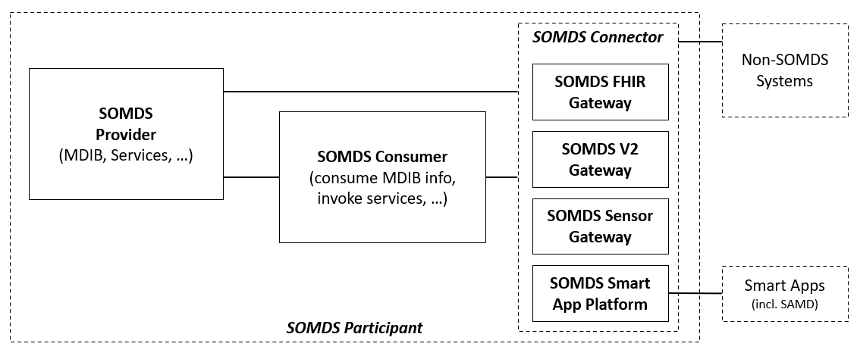
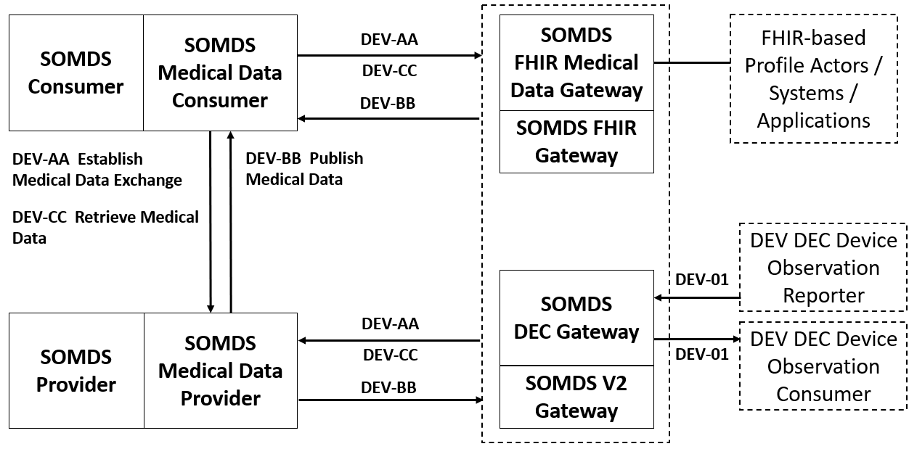
Orientation Tour: IHE Profile Actor Diagrams
SDPi-P Actor Diagram
IHE Actor
“information systems or components of information systems that produce, manage, or act on health information”
IHE Abstract Actor
Specifies behavior that is shared across / inherited by a set of IHE Actors (actor name in italics & dotted line around concrete actors)
Profile “External” Actor
Indicates actors that are outside the scope of the profile but interact with profile actors (dotted box) Note: actor may be defined in other profiles
SDPi-A Actor Diagram
IHE Grouped Actor
Indicates actors that integrate with other actors to provide their functionality (two rectangles joined side-by-side)

Slide 19
Orientation Tour: SDPi-P (Plug-and-Trust)
SDPi-P Actor Model
NOTE: SOMDS Participant actors may be devices, system applications, SAMD, “smart apps” …

Slide 20
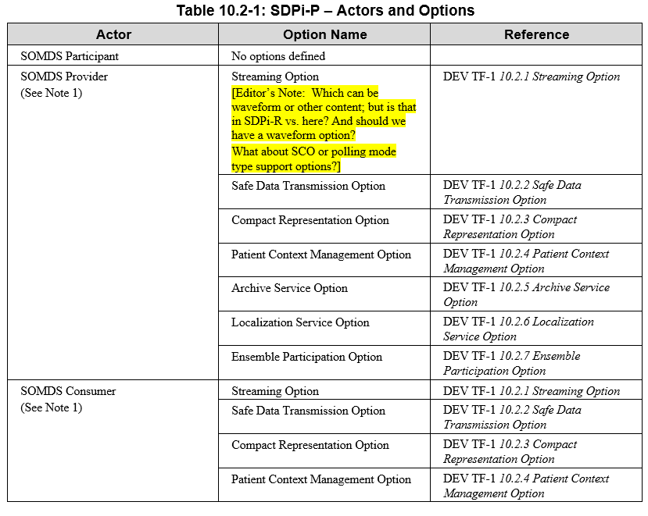
Orientation Tour: SDPi-P (Plug-and-Trust)
SDPi-P Actor Model
SDPi-P Options (partial)
Current Proposed Options
See SDPI Profile Option Specifications section for detail on each

Slide 21
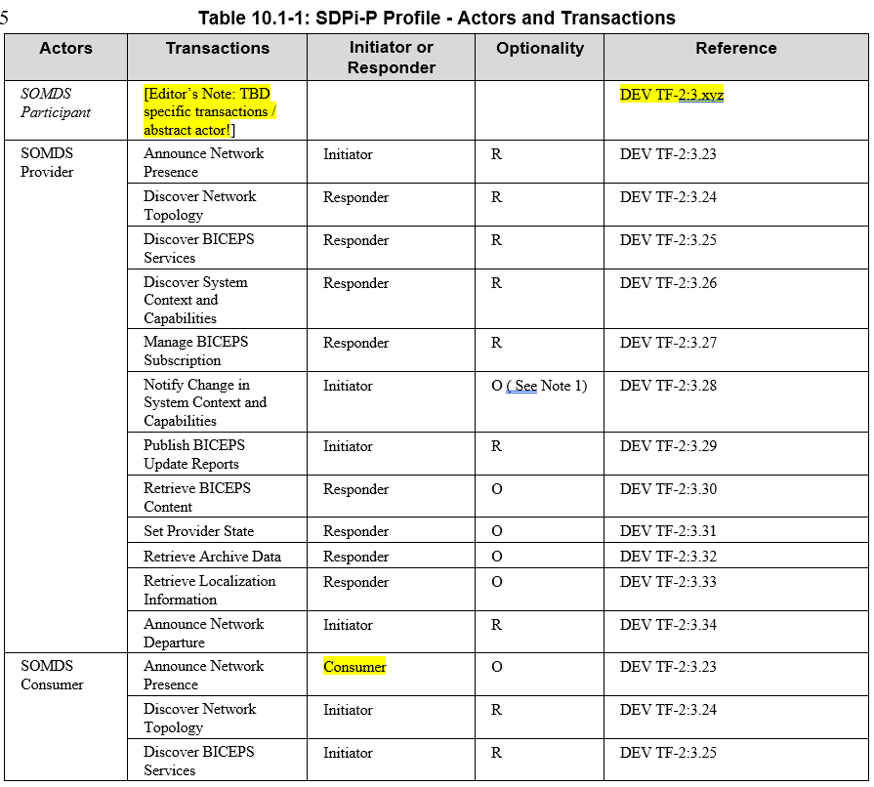
Orientation Tour: SDPi-P (Plug-and-Trust)
SDPi-P Actor Model
SDPi-P Transactions
See SDPI Transaction Specifications section for detail on each

Slide 22
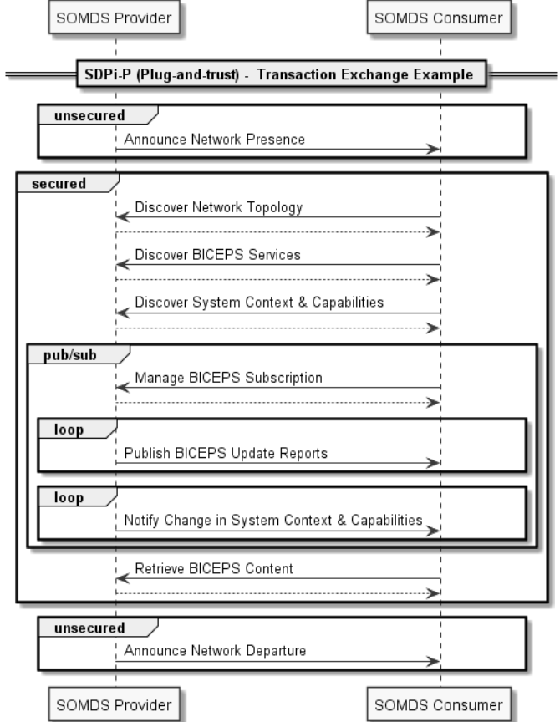
Orientation Tour: SDPi-P (Plug-and-Trust)
Example of an SDPi-P transaction exchange …
For a full set of profile-specific MDPWS sequence exchanges, see:
https://confluence.hl7.org/display/GP/SDPi+Technical+Framework+Models
NOTE: Definition of “BICEPS” abstraction level for SDPi transactions.

Slide 23
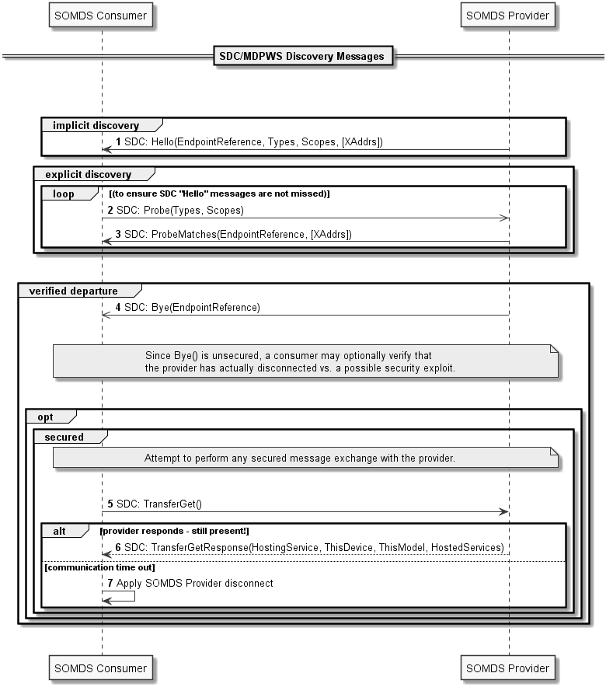
Orientation Tour: SDPi-P (Plug-and-Trust)
Example of an SDPi-P transaction MDPWS sequence
For a full set of profile-specific MDPWS sequence exchanges, see:
https://confluence.hl7.org/display/GP/SDPi+Technical+Framework+Models

Slide 24
Orientation Tour: SDPi-R (Reporting)
SDPi-R Actor Model
NOTE: Transactions are drawn to the dotted box around the gateways, indicating that they can be either Provider and / or Consumer SDPi-R actors
See SDPI Transaction Specifications section for detail on each

Slide 25
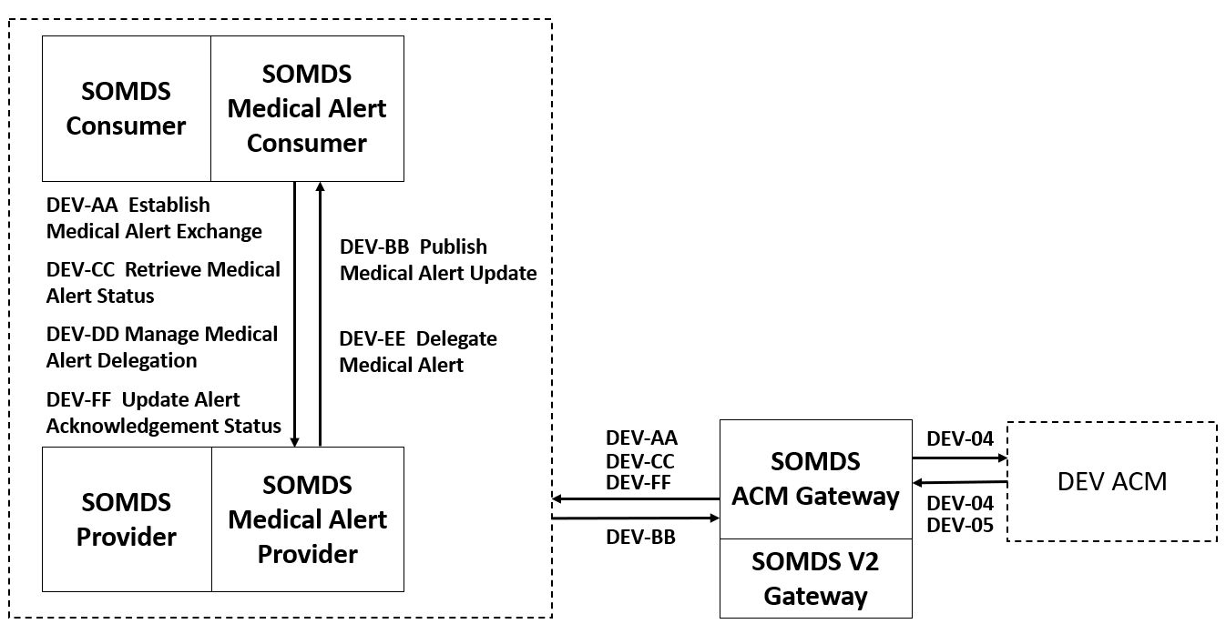
Orientation Tour: SDPi-A (Alerting)
SDPi-A Actor Model
See SDPI Transaction Specifications section for detail on each

Slide 26
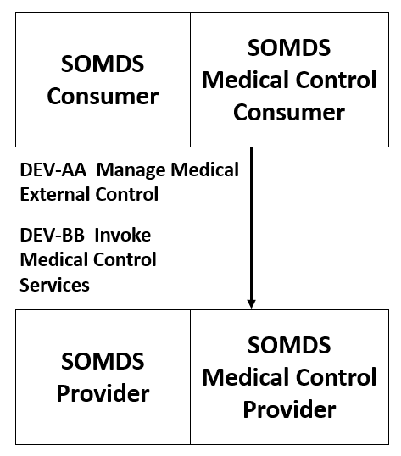
Orientation Tour: SDPi-xC (External Control)
SDPi-xC Actor Model
See SDPI Transaction Specifications section for detail on each

Slide 27
SDPi-P Option Specifications

Slide 28
SDPi-P Options: Streaming
2020.11.04
Secured waveforms in 1.0 (default) … MDPWS out-of-the-box;
Consider unsecured UDP streaming for 1.x (upon request only)
OR as an alternative transport HTTP/2 gRPC in 1.x
ADD UML version of THIS SDPi-R & add to Appendix A Waveform Service section
Define related:
transactions,
MDPWS sequences,
SOMDA Constraints,
Content Module Bindings
SDPi 1.0 or subsequent?
…
Transactions are the same as for SDPi-R -> only transport layer is different!
Out of scope for SDPi 1.0 – securing the waveform channel is extra-challenging; adds unnessecary complexity with questionable performance benefit

Slide 29
SDPi-P Options: Safe Data Transmission
2020.11.04
Message Payload is the only difference … & relies on XML;
@ gRPC – is fundamentally different & challenges (e.g., not using xpath)
Wait for -10703 for specific value proposition (incremental over baseline) +
May use this or alternative to current MDPWS (ambiguity)
Define related:
transactions,
MDPWS sequences,
SOMDA Constraints,
Content Module Bindings
SDPi 1.0 or subsequent?
…
Transactions are the same except for the message payload
Out of scope for SDPi 1.0 unless a party claims need – safe data transmission is conceptually fuzzy and brittle. Would require very specific profiling

Slide 30
SDPi-P Options: Compact Representation
2020.11.04
EXI is a “beast” of a spec; SDC libraries do not support – little market support either
HTTP/2 + gRPC would address out of the box
HTTP/1.1 … good enough , but …gzip for example FOR SDPi 1.0 for every transaction w/ option; in every transaction section
NOTE: Sequence of serialization & compression of message content varies per approach
NOTE: A key application need is for performance at scale – e.g., streaming 100’s of beds with 12 lead per bed
Consider whole SOMDS running in “compressed” mode
Add note to MDPWS Appendix A + as TBD @ EXI use; call out the HTTP/1.1 approach
Define related:
transactions,
MDPWS sequences,
SOMDA Constraints,
Content Module Bindings
SDPi 1.0 or subsequent?
…
Transactions are the same except for the message serialization
There are no serious EXI implementations on the market; SDPi should recommend/require use of HTTP compression; which is not optimal but widely adopted

Slide 31
SDPi-P Options: Patient Context Management
2020.11.04
Defer (?) to SDPi 1.x – what is needed NOW vs. when connecting to enterprise applications
MUST do something in 1.0 to ensure safety of all exchanges – IOW what is IN this option vs. must be supported by the base SDPi-x profiles? In SDPi-P vs. –R / -A / -xC require it
What use cases NOW will rely on this? A Patient-Device Association Management Source of Truth within a System of Products / SOMDS implementation
What will be baked into the related PKP standards? – the preconditions are baked into the PKP, not how you can make sure the data is the needed Quality (e.g., reliability)
Define related:
transactions,
MDPWS sequences,
SOMDA Constraints,
Content Module Bindings
SDPi 1.0 or subsequent?
…
I guess I need more context here (hihi). Let‘s talk about that on Wednesday

Slide 32
SDPi-P Options: Archive Service
2020.11.04
No real experience / use case that drives the message exchanges …
Therefore, no way to VALIDATE that what is supported is sufficient
Supports 5-10 minutes / off-line period for “backfilling” … network connection loss only – no Provider restart etc.
Not 100+ hours of full disclosure … this would require a different persistence layer & …
Relationship with (MDIRA/ICE) DataLogger Actor specification?
SDPi 1.0 will be narrow Provider off-line backfilling & SDPi 1.x / MDIRA for Full-Disclosure of a forensics data logging capability TBD
Define related:
transactions,
MDPWS sequences,
SOMDA Constraints,
Content Module Bindings
SDPi 1.0 or subsequent?
…
I can prepare best-practice sequences; nevertheless the Archive Service as specified in BICEPS does not cover all variations of archival access – backfilling yes, full closure no

Slide 33
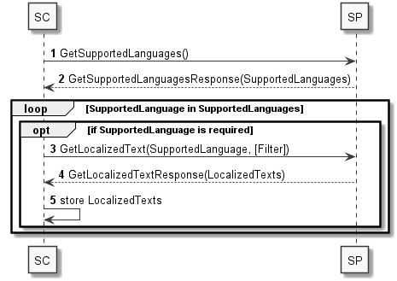
SDPi-P Options: Localization Service
Define related:
transactions,
MDPWS sequences,
SOMDA Constraints,
Content Module Bindings
SDPi 1.0 or subsequent?
…
I can prepare best-practice sequences by inspecting our productive implementation
2020.11.04
Change option name to Language Service
Use in SDPi 1.0
NOTE: different from LocationContext support
Example message content is the interesting part!

Slide 34
SDPi-P Options: Ensemble Participation
2020.11.04
Need to establish INITIAL base use cases for SDPi 1.0 …
This is closely related to the SFC definition / management
Identify basic use of SystemContext objects for this use
Basic “fixed” workplace … establish base sequence / approach w/ constraints
NOTE: SES & clinical workflow / personnel “understanding” is key
TBD use of mobile devices or multi-patient (spot check) devices, etc.
Related to Patient-Device Association (Patient Context) Option
Advanced could factor in:
Mobile devices
Patient centric devices (e.g., blood gas measurement or telemetry)
CLC actors
…
Define related:
transactions,
MDPWS sequences,
SOMDA Constraints,
Content Module Bindings
SDPi 1.0 or subsequent?
…
This is a hard nut to crack – we‘ll have general rules in PKP, but the magic happens beyond that ruleset.
We don‘t have any experiences right now, just some learnings from Dräger‘s CAP leveraging the location context… much room for development here

Slide 35
SDPi TF-2 Transactions & MDPWS Messaging

Slide 36
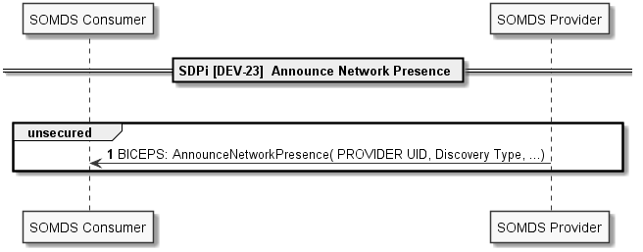
SDPi TF-2: DEV-23

Slide 37
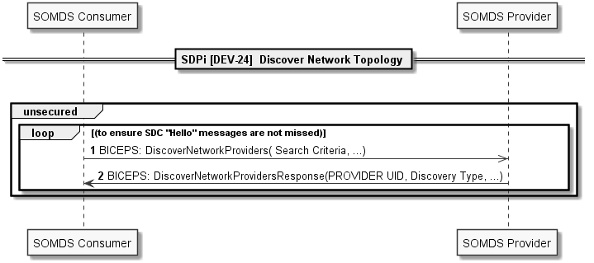
SDPi TF-2: DEV-24

Slide 38
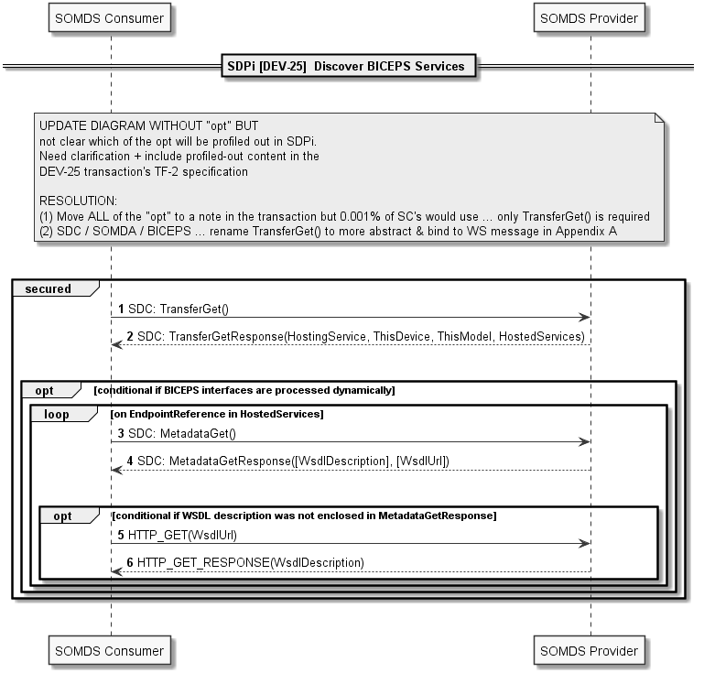
SDPi TF-2: DEV-25
Both opts are unnecessary if the BICEPS interface is known a-priori – which it is partially → we might need some additional profiling to unambigiously determing BICEPS service actions. I‘ll double-check that
Only highly dynamic implementations would require to resolve hosted services and WSDLs – unlikely for medical devices
2020.11.04
For SDPi: Normatively reference WSDL file from <XYZ> (e.g., IHE Github IO?) ADD to repo etc.
Make WSDL file mandatory for all SDPi Providers
ACTION: David G. will update WSDL to remove optionality & ambiguity – cleaner & nicer ☺
Include note & future option (???) for retrieving WSDL for each service IF Provider & services are new.

Slide 39
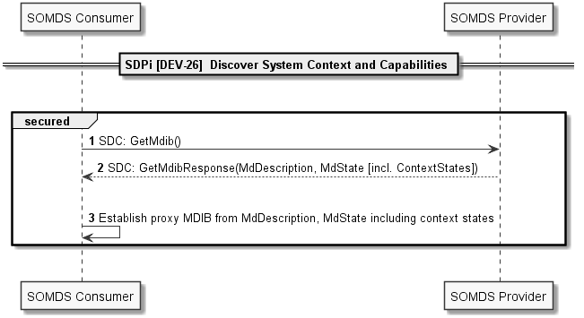
SDPi TF-2: DEV-26

Slide 40
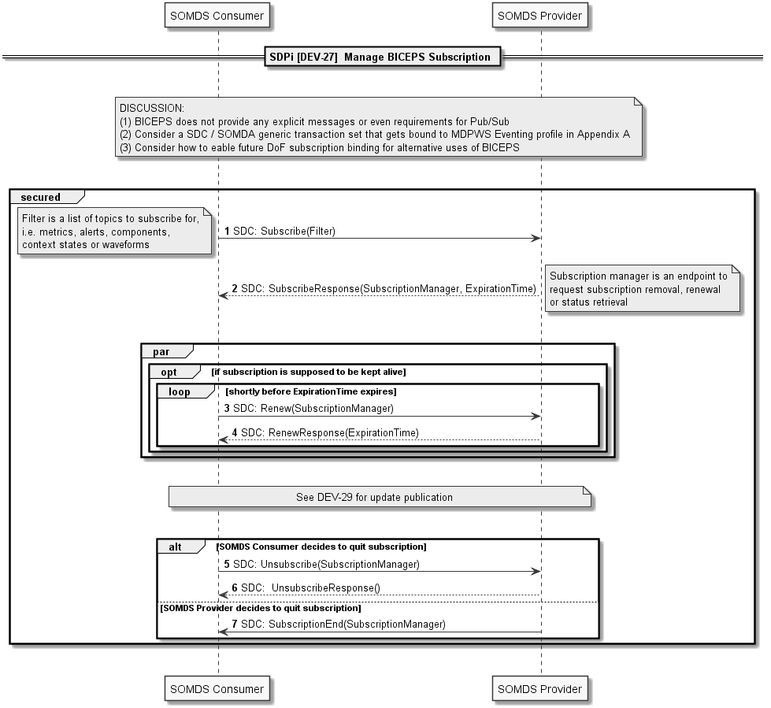
SDPi TF-2: DEV-27

Slide 41
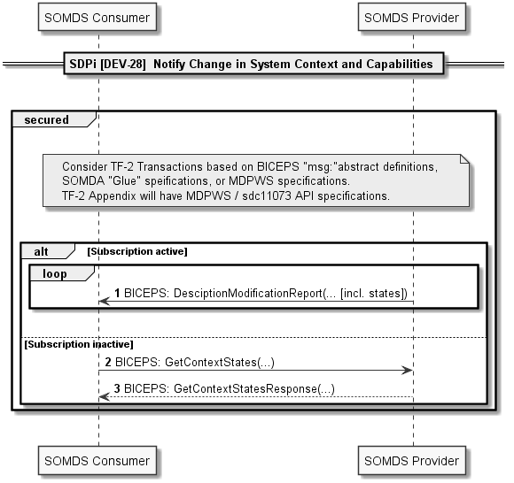
SDPi TF-2: DEV-28

Slide 42
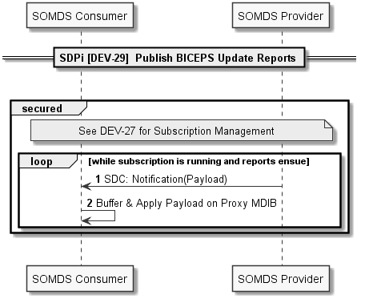
SDPi TF-2: DEV-29

Slide 43
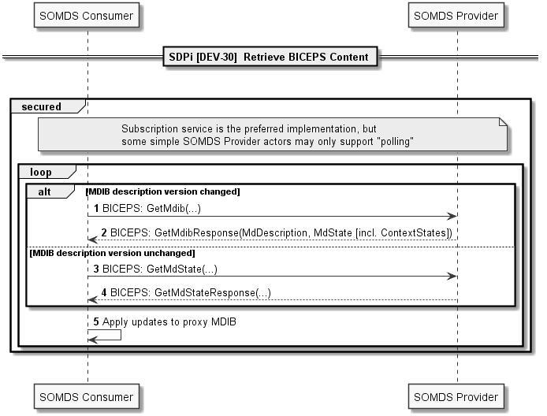
SDPi TF-2: DEV-30

Slide 44
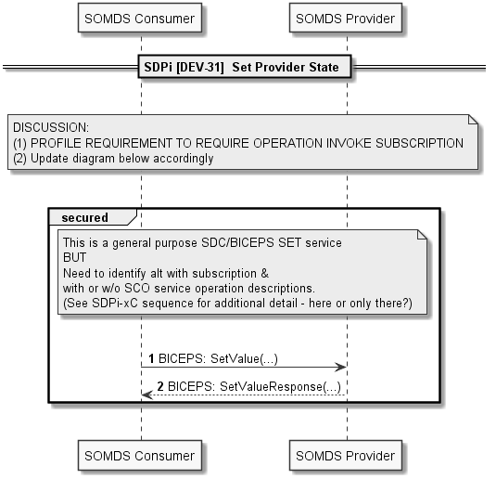
SDPi TF-2: DEV-31

Slide 45
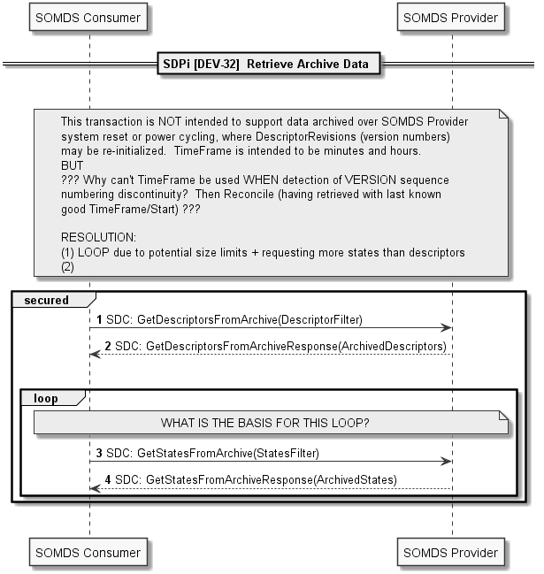
SDPi TF-2: DEV-32
The loop is based on try-and-error – one could request „nested intervals“ (is that the right term, I only know the German one… and the translators suck sometimes.
The whole ArchiveService – as already mentioned – is wonky and insufficient. Hard to profile, but partially better with HTTP/2
2020.11.04
Sync with the earlier Option slide context & constraints
Descriptors will have time frame (e.g., 4 hours) …
States may be overrun by high frequency data
Strategy: Approximation by try/fail/try again @ ½ size
Challenge is staying under the 4MB limit …
No support now for a “stream” of archive data – only request / response and need to approximate in REAL TIME optimal data frame size.
NOTE: At HTTP/2 provides simple stream for bi-directional exchange
Archive 2.0 service may address / or alternative transport etc.

Slide 46
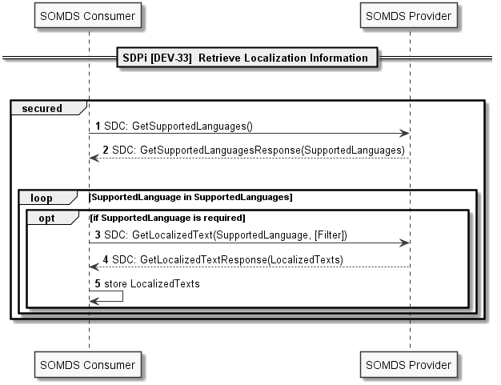
SDPi TF-2: DEV-33

Slide 47
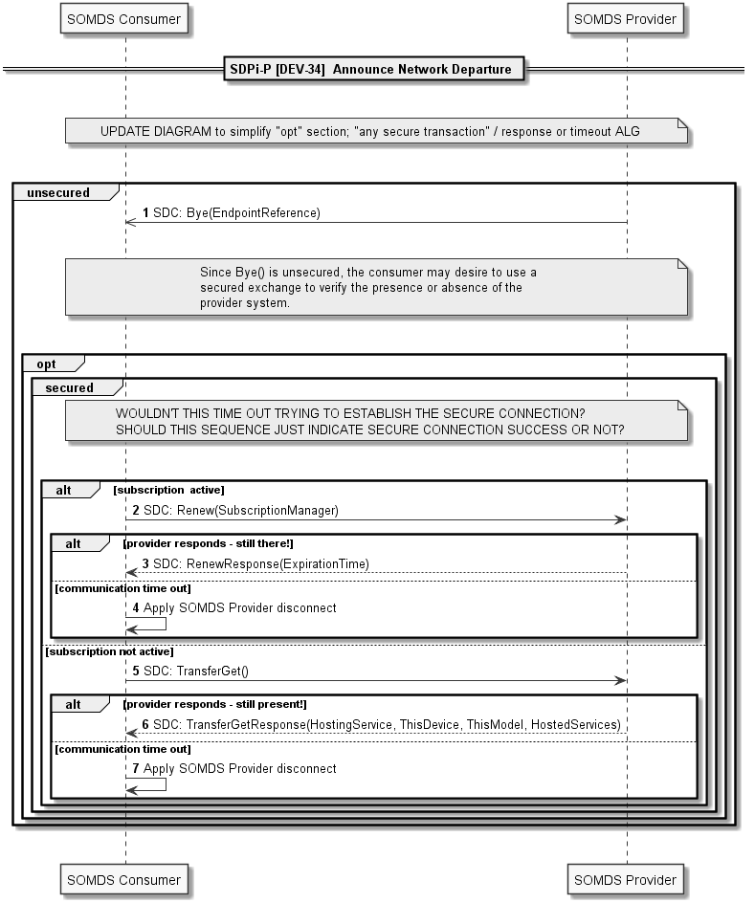
SDPi TF-2: DEV-34

Slide 48
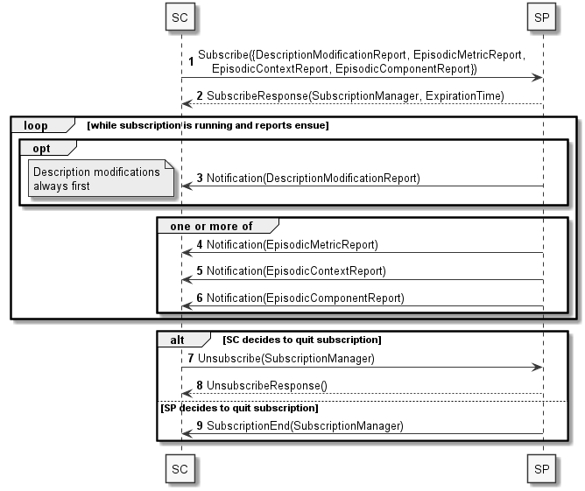
SDPi TF-2: DEV-35
3.35 Establish Medical Data Exchange [DEV-35]

Slide 49
SDPi TF-2: DEV-36
3.36 Publish Medical Data [DEV-36]

Slide 50
SDPi TF-2: DEV-37
3.37 Retrieve Medical Data [DEV-37]
Note this is a polled retrieve vs. pub/sub eventing

Slide 51
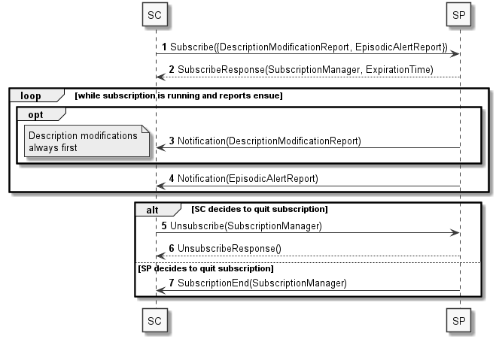
SDPi TF-2: DEV-38
3.38 Establish Medical Alert Exchange [DEV-38]

Slide 52
SDPi TF-2: DEV-39
3.39 Publish Medical Alert Update [DEV-39]

Slide 53
SDPi TF-2: DEV-40
3.40 Retrieve Medical Alert Status [DEV-40]

Slide 54
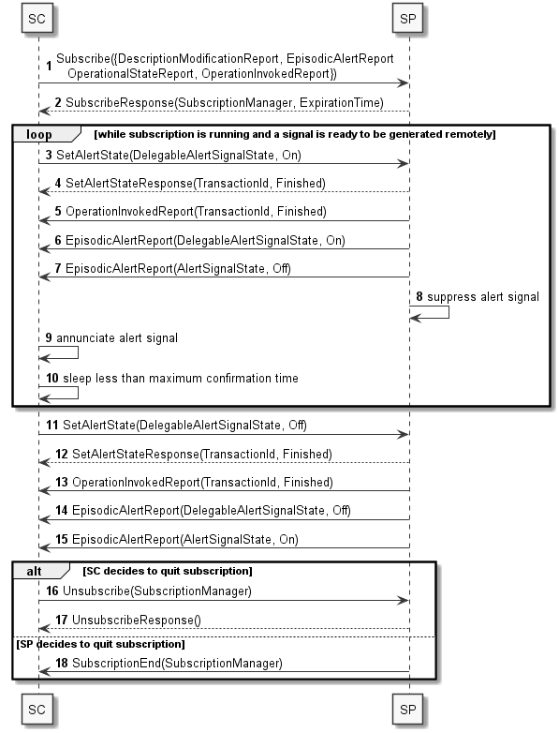
SDPi TF-2: DEV-41
3.41 Manage Medical Alert Delegation [DEV-41]

Slide 55
SDPi TF-2: DEV-42
3.42 Delegate Medical Alert [DEV-42]

Slide 56
SDPi TF-2: DEV-43
3.43 Update Alert Acknowledgement Status [DEV-43]

Slide 57
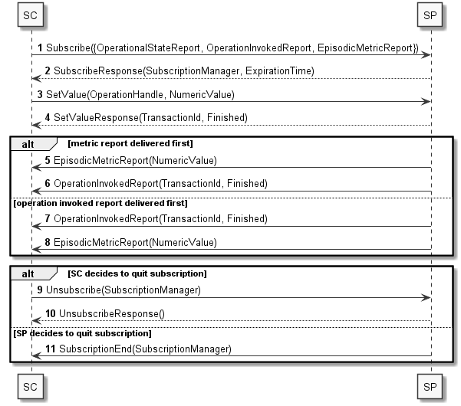
SDPi TF-2: DEV-44
3.44 Manage Medical External Control [DEV-44]

Slide 58
SDPi TF-2: DEV-45
3.45 Invoke Medical Control Services [DEV-45]

Slide 59
SDPi TF-3 SDC/BICEPS Content Modules & Specializations

Slide 60
SDPi TF-3: SDC/BICEPS Content Modules - General
Topics to be covered in the General BICEPS semantic profiling section:
Link to TF-1 SDPi-P Content Modules & same for other profiles?
Extension model
General (all device specializations)
SDPi 1.0 or subsequent?
… (see subsections in outline)

Slide 61
SDPi TF-3: SDC/BICEPS – Infusion Pumps
Topics to be covered in the BICEPS infusion pump profile section

Slide 62
SDPi TF-3: SDC/BICEPS – Physiologic Monitor
Topics to be covered in the BICEPS physiologic monitor profile section

Slide 63
SDPi TF-3: SDC/BICEPS – Ventilator
Topics to be covered in the BICEPS ventilator profile section

Slide 64
SDPi TF-3: SDC/BICEPS – Surgery Devices
Topics to be covered in the BICEPS surgery devices profile section

Slide 65
Additional
Information

Slide 66
Real-world Narrative: Isolation ICU
Pandemic Patients in an Isolation ICU – EUA Remote Control Narrative
In dealing with severely infectious patients, healthcare workers (HCWs) are at a significantly greater risk of infection than the overall population due to their frequency and time in contact with the infected patients. The HCWs will enter the patient room to administer care to the patient and manage the therapeutic equipment. This management of the patient’s therapy may require frequent device adjustments which may be delayed due to the need for the HCWs to protect themselves by donning PPE prior to entering the patient room and doffing the PPE upon leaving. This donning and doffing processes can exceed 15 minutes depending on the specific PPEs used. A recent study (Suen, 2018) reported times of 7 minutes for donning and 10 minutes for doffing, with the doffing process providing the opportunity for “considerable” self-contamination.
Infectious diseases confer a synergistic burden on and risk to the patient due to the requirements for isolating the patient (Abad et al., 2010) including poorer care and impaired coordination of care, (Mehrotra et al., 2013), significantly fewer HCW and family visits (relative to patients not on precautions) (Morgan et al., 2013), increased rate of adverse events (Stelfox et al., 2003) and increased depression (compared to other inpatients). (Day et al., 2011). The use of remote control and monitoring can be used to eliminate some treatment delays, reduce the infection risk to the HCW, and help preserve the limited supplies of PPE and improve patient care.
Critically ill patients with an infectious disease will often require monitoring with physiologic monitors and therapeutic support with ventilators and infusion pumps. As previously explained, entering the room to view parameters or adjust any settings can require 15 minutes for something that may take less than 1 minute. Medical devices that support open interoperability technology can provide remote access to view parameters and adjust settings thereby increasing efficiency, saving the costs of the PPE and most importantly increasing the safety of the HCW.
Source: Adapted from AAMI CR Proposal: “Emergency Use Guidance for Remote Control of Medical Devices"

Slide 67
Real-world Narrative: Isolation ICU
Pandemic Patients in an Isolation ICU – Scenarios?
For the purposes of this PAT, what scenarios are of greatest interest?
Participant Discovery / Security / Service Exchange?
Patient / Participant Association (Patient & Location & Workflow context establishment)?
Alert delegation / Alert Limit Adjustment / Alert confirmation / Silence ... ?
Which devices, systems, applications? Monitors, vents, pumps, central … others?
Integration with EHR or other system?
Use of IHE-based FHIR profiles for integration with non-SDPi / non-SDC SOMDS systems?
…
Other Use Cases / Scenarios? (e.g., surgery focused)

Slide 68
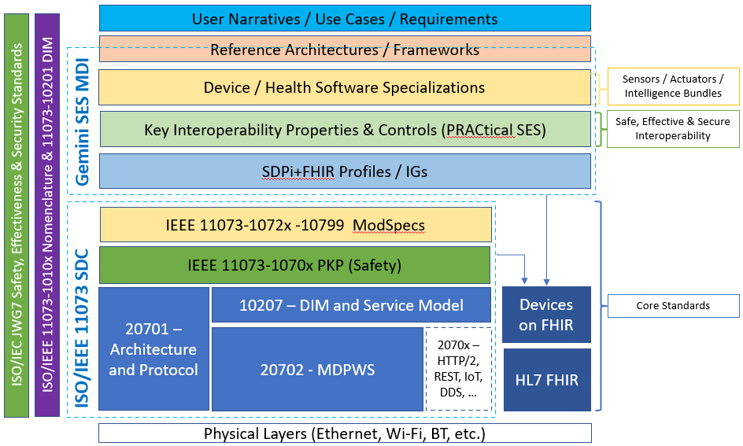
Hanging Gardens: After SDPi 1.0 …
NOTE: Profile Titles are notional – hopefully useful too!
Devices-In-Care (PDP) Profile
Device Specialization Profile
Surgery PoC Profile
ICU PoC Profile
MDIRA ICE Profile
SOMDS@home Profile
IHE (Official) Profile Types:
Transport, Content, Workflow
Or a combination of all (3)
Other types?
Architecture (SOA, MDIRA, SDC, ….?
Single domain / multi-domain?

